Slide 1
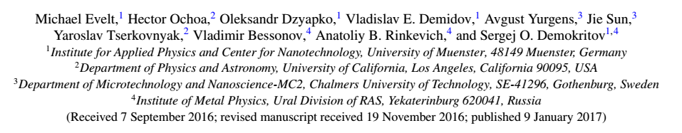
Chiral charge pumping in graphene deposited on a magnetic insulator
Yunyan Yao
20170512

Slide 2


About authors
University of Muenster(Germany)
Ural Division of RAS (Russia)
research area
Time resolved measurements of dynamical magnetic processes
Spin wave excitation through spin polarized current
Optical spectroscopy on magnon Bose-Einstein condensates
Sergej O. Demokritov
Group members:
Michael Evelt
Oleksandr Dzyapko
Vladislav E. Demidov

Slide 3
motivation
In spin pumping system, as the thickness of the metallic layer is reduced, additional interfacial effects must be considered. The different contributions may be identified by analyzing the symmetries of the voltage signal with respect
to different adjustable parameters
Single layer graphene(SLG)
Spin-wave induced interfacial effects
Magnetic material(YIG)
Microwave
field

Slide 4
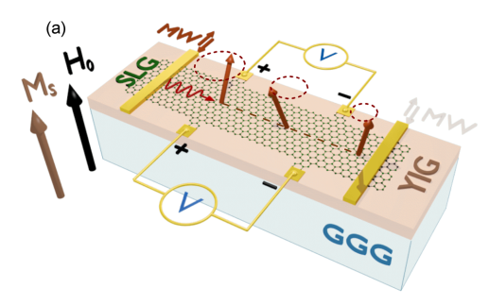
schematic
Thickness: YIG(5.1um),GGG(0.5mm);
Saturation magnetization of YIG with out-of-plane geometry 4πM_{S} =1.75 kG ;
Gold contact patches indicated by (+) and (-) were used for electric measurements;
Spin waves are excited by microwave (MW) current flowing in one of the two narrow antennas, producing a local MW field;
The red arrows represent the precession of the exchange field following the magnetization dynamics

Slide 5
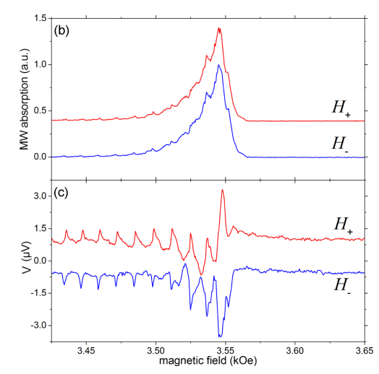
Microwave & voltage measurement
temperature T=295 ±0.02 K, H_{o} > 2KOe;
Figure(b),keep f constant,vary H_{o}, characterizing the field-dependent excitation of spin waves in YIG;
odd number constant spin wave modes resonance
number of small peaks
a large absorption peak
FMR
Figre(c), measured voltage versus the applied magnetic field.
H₋ is the inversion of H₊.
to MW absorption vs field, no visible change
to measured voltage vs field, change sign
?

Slide 6
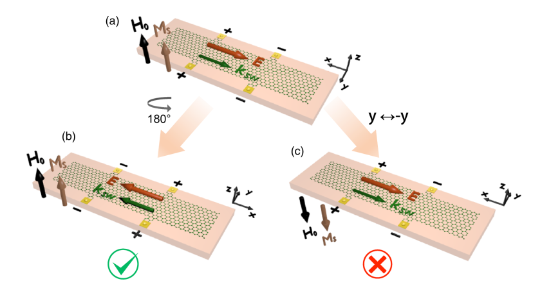
Symmetry breaking
the reference geometry
Rotation by 180◦ around the z axis
Mirroring with respect to the vertical xz plane (y → -y)

Slide 7
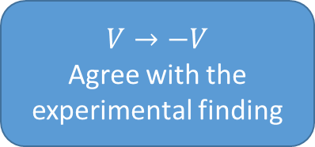
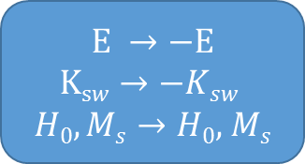
Symmetry breaking
Rotation symmetry around the normal axis is existed
rotation by 180◦ around the normal to the film plane
$$E →−E$$
$$\text{K}\text{s}w→−Ksw$$
$H0,Ms→H0,$ $Ms$
$$V→−V$$
Agree with the experimental finding

Slide 8
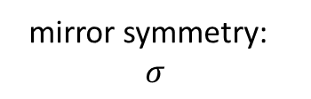
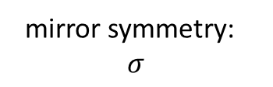
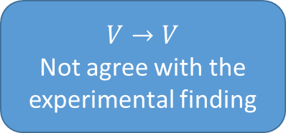
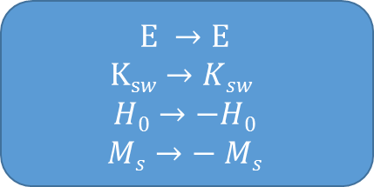
Symmetry breaking
mirror symmetry:
$$σ$$
axial vector:A
(as H₀,M_{s})
mirror symmetry:
$$σ$$
real vector:A
(as E,K_{sw})
the mirror reflection symmetry about the planes normal to the interface is broken
Mirroring with respect to the vertical xz plane (y → -y)
$$E →E$$
$$\text{K}\text{s}w→Ksw$$
$$H0→−H0$$
$Ms→−$ $Ms$
$$V→V$$
Not agree with the experimental finding

Slide 9
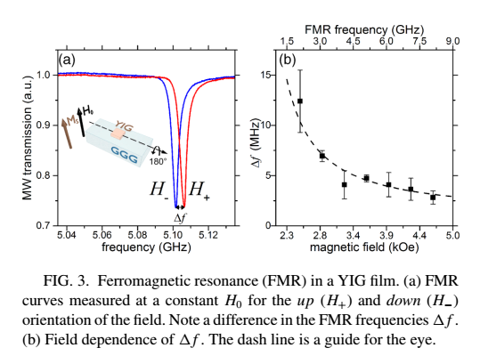


FMR in YIG film
Aim : to check whether the observed nonequivalence is a characteristic feature of the YIG film itself;
$$Δf$$
systematically increases as H₀ approaches 4πM_{S} = 1.75 kG
the frequency of the FMR in YIG films depends on whether the static magnetic field is parallel or antiparallel to the normal to the film surface
$$\vec{z}$$
depends on the direction (clockwise or counterclockwise
with respect to zˆ) of the magnetization precession.
mirror reflection symmetry about interface is broken

Slide 10
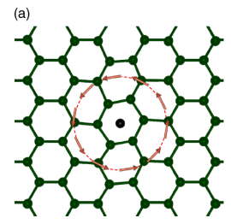
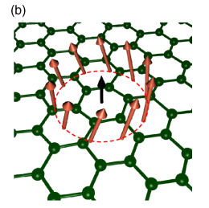

Phenomenological model
based on the existence of a finite density of
screw dislocations in YIG
The voltage signal is related to the electromotive forces induced by the magnetization dynamics
exchange interaction couples the spins of itinerant electrons of SLG to the localized magnetic moments in YIG
The tilted exchange field translates the effect of the symmetry breaking in YIG into the electronic response of graphene
displacements of the carbon atoms
related to H₀
related to K_{sw}

Slide 11
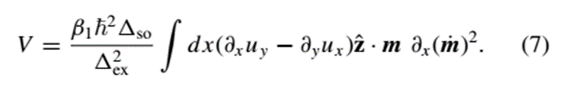
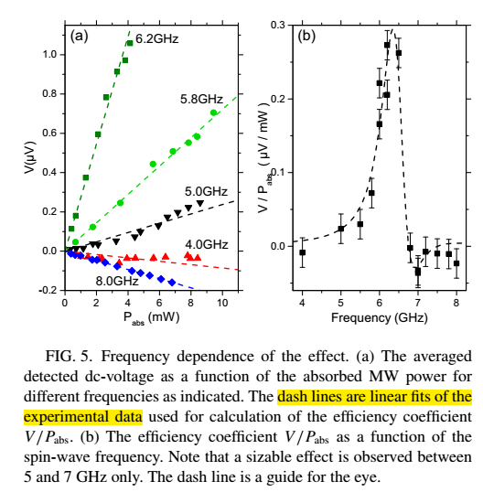
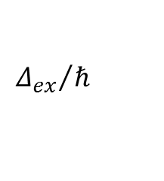
Frequency dependence
predicts that the effect should exist only within a certain range of spin-wave frequencies around
$${Δ_{ex}}/ℏ$$
voltage is linearly proportional to the spin-wave intensity
the frequency dependence of V/P_{abs} exhibits a resonance-like behavior with the maximum at about 6 GHz

Slide 12
conclusions
experimentally observe a chiral charge pumping in YIG/SLG bilayers caused by the symmetry breaking at the YIG surface
The broken symmetry of the studied YIG film has been also experimentally confirmed by FMR measurements in bare YIG films
The developed theoretical model, predicts that the strength of the effect can be increased by making use of 2D conductors with a strong spin-orbital coupling, such as MoS₂

